Slide 1
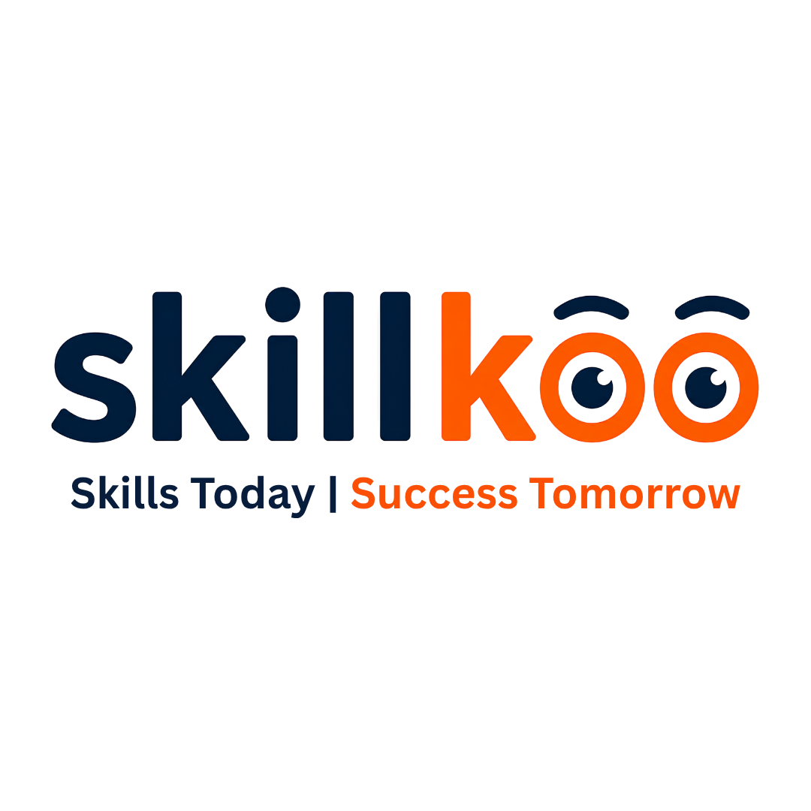
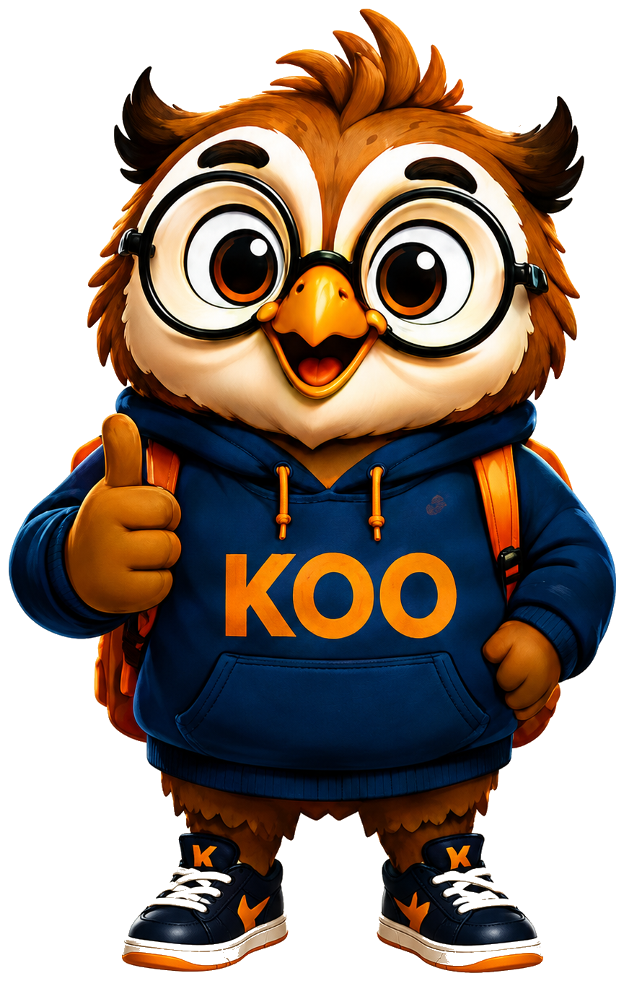
Future-Ready School Ecosystem
Career Discovery
Future Skills
Psychometric assessment
AI-supported career and stream guidance
Personalized career roadmap
Skill-based programs
Real-world projects
Portfolio and certifications
AI Learning
Parent Confidence
AI mentor support
AI-Assisted Projects
Future Technology Awareness
Clear visibility
Better support for stream selection
Regular reports & counselling insights
SkillKoo | Where Passion Becomes Profession
01

Slide 2
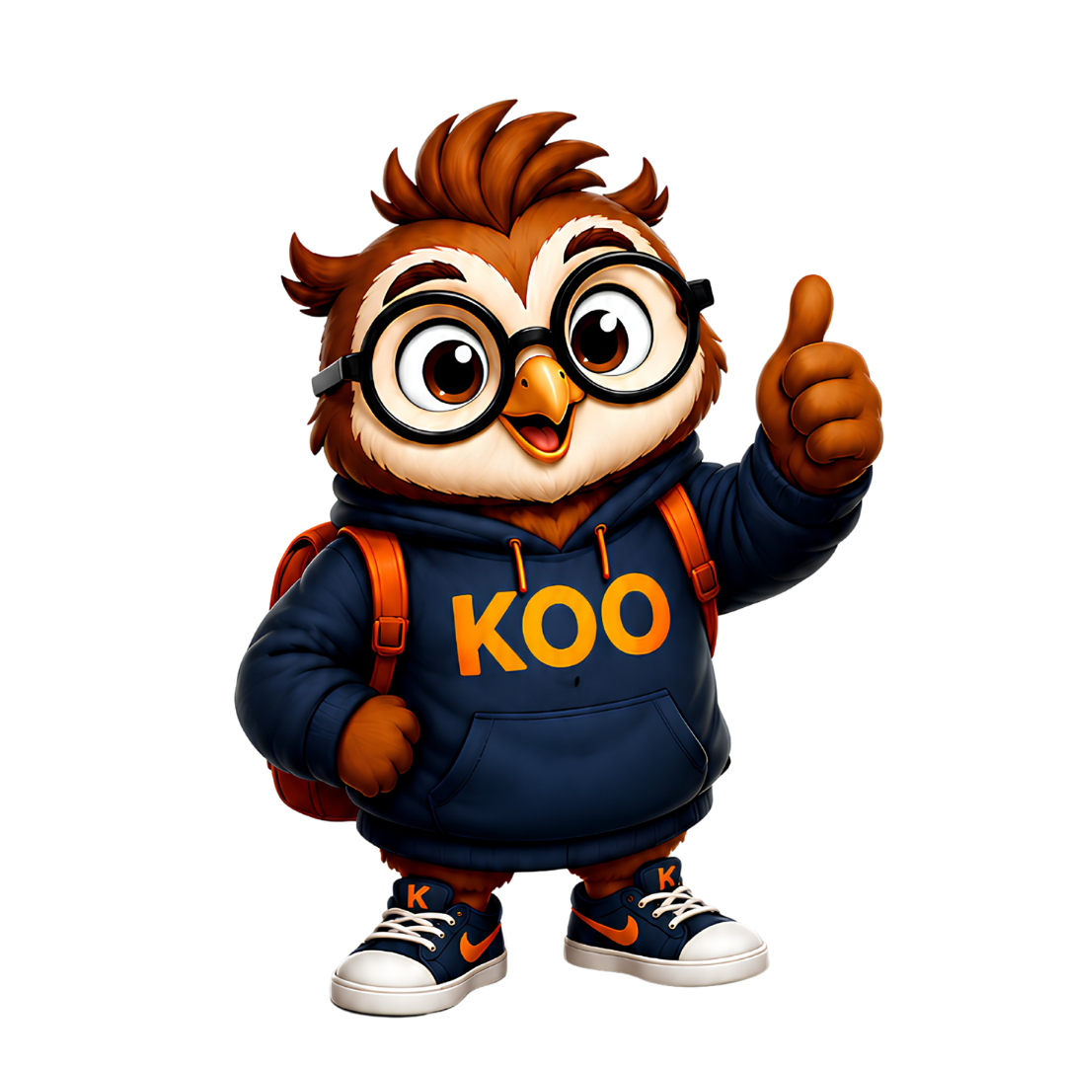
K
SKILLKOO
ABOUT SKILLKOO
What SkillKoo Is
A future skills and career discovery ecosystem for Class 6 to 12 students.
1
Explore
2
Learn
Strengths, interests and career direction
AI, entrepreneurship, communication and emerging skills
3
Build
4
Report
Projects, certificates and student portfolios
Dashboards for school, parents and outcomes
Management message: SkillKoo converts “career guidance” into a structured student-development system.
SkillKoo | Where Passion Becomes Profession
02

Slide 3
K
SKILLKOO
WHY NOW
Education Has Shifted From Marks to Capability
Schools are judged by how ready their students are for life, university and careers.
Old Question
New Leadership Question
“What marks did the student score?”
“What can the student actually do?”
AI + emerging careers + portfolio-based opportunities demand visible student outcomes.
The opportunity: position the school as future-ready before this becomes a parent expectation.
SkillKoo | Where Passion Becomes Profession
03

Slide 4
K
SKILLKOO
SKILLKOO MODEL
Four Pillars That Create Differentiation
A simple framework senior management can communicate to parents and stakeholders.
CR
SK
AI
PR
Career Readiness
Skill Building
AI Mentor
Projects & Portfolio
Stream clarity, career paths and university awareness
AI, digital, communication, entrepreneurship and leadership
Personalized recommendations, guided learning and smart support
Proof of work, certificates and outcomes beyond marks
This gives the school a clear brand language: readiness, skills, AI and portfolios.
SkillKoo | Where Passion Becomes Profession
04

Slide 5
K
SKILLKOO
Why SkillKoo Matters to School Leadership
The model supports academic leadership, parent trust and market positioning.
Future-ready school positioning
Strategic Benefit
Visible student-success outcomes
SkillKoo helps the school move from “we offer guidance” to “we produce measurable student readiness.”
Parent-facing confidence and clarity
NEP-aligned skill-development narrative
Scalable model without overloading teachers
For management: this is a differentiation and retention strategy, not only a student learning product.
SkillKoo | Where Passion Becomes Profession
05

Slide 6
K
SKILLKOO
Schools Are No Longer Judged Only by Results
Schools are expected to deliver beyond academics while maintaining performance and parent satisfaction.
01
Academic excellence
02
Career guidance
03
Skill development
04
Mental wellness
05
NEP implementation
06
Technology awareness
07
Entrepreneurship exposure
08
Parent satisfaction
09
Student engagement
10
Future readiness
Challenge: managing all this internally can dilute focus and stretch school resources.
SkillKoo | Where Passion Becomes Profession
06

Slide 7
K
SKILLKOO
SOLUTION
SkillKoo as the Future-Ready School Layer
A plug-in ecosystem that adds assessment, AI guidance, projects and reporting to existing academics.
Assess
→
Recommend
→
Learn
→
Build
→
Report
Psychometric + interest mapping
AI career and stream guidance
Future-skill learning modules
Projects, certificates, portfolios
School and parent progress view
The school gets an end-to-end ecosystem while academics continue normally.
SkillKoo | Where Passion Becomes Profession
08

Slide 8
K
SKILLKOO
Why Schools Should Prefer SkillKoo
SkillKoo helps schools differentiate in a competitive market with measurable outcomes.
Brand Differentiation
Parent Confidence
Scalable Execution
Position the school as future-ready, AI-aware and outcome-focused.
Give parents clarity through assessments, reports and visible student progress.
Run at school scale with AI, dashboards, workshops and structured programs.
This is a low-disruption, high-perception initiative for school leadership.
SkillKoo | Where Passion Becomes Profession
10

Slide 9
SKILLKOO
1
Counselling at Scale, Lower Operational Load
SkillKoo supports career guidance and NEP-aligned future readiness without creating a heavy internal manpower burden.
Less dependency on full-time counsellors
Expert intervention where needed
Dashboard for review
AI assessments, interest reports and pathway suggestions reduce repetitive guidance work.
Human counsellors focus on priority cases, parent discussions and critical decisions.
Management gets structured indicators, participation data and outcome visibility.
AI + Live
Hybrid guidance
Reports
for each student
Lower Load
for school teams
NEP-ready
student support
Scalable career guidance without building a large internal counselling department.
SkillKoo | Where Passion Becomes Profession

Slide 10
K SKILLKOO
2
Your school Becomes an AI-Enabled Future-Ready Campus
SkillKoo creates a visible AI learning layer that parents and students can understand immediately.
AI Mentor KOO
AI Learning Exposure
AI Campus Identity
Personalized reminders, guidance and learning direction for every student.
Students experience AI tools, future technologies and self-paced learning from school level.
Your school can position itself as an AI-aware school preparing students for emerging careers.
Traditional Learning
AI-Driven Future Campus
Your school gains a powerful innovation story — AI learning, AI guidance and future-ready positioning.
SkillKoo | Where Passion Becomes Profession

Slide 11
K SKILLKOO
3
A Strong Differentiation & Admissions Advantage
SkillKoo helps your school communicate outcomes beyond marks — clarity, skills, projects and portfolios.
Different from other schools
Stronger parent pitch
Visible success stories
Admissions confidence
Your school can showcase future skills, AI learning, psychometric assessments and portfolio outcomes.
Parents see a clear roadmap: assessment, learning, project and report.
Monthly challenges, certificates and project showcases create content for school branding.
A future-ready ecosystem strengthens your school admission counselling story.
Brand
Future-ready
Admissions
Stronger narrative
Showcase
Student projects
Retention
Parent trust
SkillKoo becomes a differentiation strategy, not only an app or course platform.
SkillKoo | Where Passion Becomes Profession

Slide 12
K SKILLKOO
4
Higher Parent Confidence Through Visible Proof
SkillKoo converts career guidance from verbal assurance into trackable reports, portfolios and progress snapshots.
Clear student profile
Progress visibility
Better PTM conversations
Psychometric and interest insights help parents understand strengths, preferences and direction.
Parents see student learning, project participation, certificates and career readiness.
Schools can discuss student growth with data, not only marks and attendance.
Assess
Report
Project
Review
Better parent confidence, stronger trust and more meaningful school communication.
SkillKoo | Where Passion Becomes Profession

Slide 13
K SKILLKOO
5
Measurable Transformation for Your school Management
The implementation gives your school a reviewable, scalable and showcase-ready student development ecosystem.
Measurable outcomes
Your school Academy scale-up
45-day pilot proof
Student assessments, project completion, certificates, reports and dashboard review.
Your school character, wellness and life-skills programs can be digitized and expanded as structured programs.
Management can evaluate adoption, interest and measurable outcome before full-scale rollout.
Start
Engage
Showcase
Alignment + orientation
Projects + workshops
Reports + outcomes
Your School can prove transformation through data, dashboards, portfolios and parent-visible outcomes.
SkillKoo | Where Passion Becomes Profession

Slide 14
K SKILLKOO
6
NEP 2020 ALIGNMENT
NEP Readiness Made Practical for your school
SkillKoo helps your school convert NEP direction into visible school practices, documented student outcomes and parent-facing proof.
Skill & Vocational Exposure
Holistic Development
NEP-READY
SCHOOL
EVIDENCE
Future-skill streams, career awareness and guided exploration from school level.
Career clarity, communication, leadership, wellness and confidence-building.
Experiential Learning
Digital & AI Literacy
Projects, challenges, workbooks and portfolio tasks create learning by doing.
AI mentor, smart recommendations, dashboards and technology exposure.
Your school gets NEP-aligned evidence through assessments, projects, dashboards, certifications and reports.
SkillKoo | Where Passion Becomes Profession

Slide 15
K SKILLKOO
7
COST-EFFECTIVE TRANSFORMATION
One Platform Replaces Multiple Separate Initiatives
SkillKoo bundles counselling support, assessments, future-skill courses, AI learning, projects, reports and parent visibility into one scalable school model.
Traditional Separate Setup
• Career counsellor sessions
• Psychometric vendor
• AI/future-skill workshops
• Project tracking system
• Parent reporting system
SkillKoo Integrated Model
80% AI Scale
Assessments, recommendations, videos and dashboards
20% Live Touch
Orientation, workshops, review and mentoring
Built-in Proof
Reports, certificates, portfolios and parent visibility
Higher coordination + recurring vendor load
Lower implementation load + stronger parent-facing value
One ecosystem lowers fragmentation while increasing visibility, reporting and future-ready positioning.
SkillKoo | Where Passion Becomes Profession

Slide 16
K
SKILLKOO
80% AI Scale + 20% Live Human Touch
HYBRID MODEL
A school-friendly implementation that is affordable, scalable and engaging.
80% AI-Enabled
20% Live Support
Assessments
Orientation sessions
AI recommendations
Expert workshops
Self-paced videos
Teacher ambassadors
Dashboards and reports
Monthly review
This reduces school workload while maintaining a human connection for trust and adoption.
SkillKoo | Where Passion Becomes Profession
12

Slide 17
K
SKILLKOO
FOR YOUR SCHOOL
A Customized Future-Ready Student Ecosystem
SkillKoo can complement your school strengths in academics, character development and holistic learning.
Your School Strengths + SkillKoo Scale
Implementation Advantage
Character building + future skills
AI awareness and project-based learning
Mental wellness + career clarity
Parent engagement and progress visibility
Your School Academy curriculum digitization
Teacher and student ambassador model
Student leadership and innovation challenges
Measurable outcomes for management review
Your school can lead with a distinct model: academics + wellness + character + future skills.
SkillKoo | Where Passion Becomes Profession
14

Slide 18
K
SKILLKOO
BEFORE VS AFTER
School Without SkillKoo vs School With SkillKoo
A simple comparison for directors and management decision-making.
Without SkillKoo
With SkillKoo
Career guidance is occasional
Structured assessment and pathways
Student skills are not tracked
Skill progress and portfolios visible
Parent confidence depends on verbal updates
Parents get clarity and progress proof
Projects and portfolios remain limited
AI + live mentoring ecosystem
Future-readiness is hard to showcase
School can showcase future-ready outcomes
SkillKoo | Where Passion Becomes Profession
15

Slide 19
K
SKILLKOO
COURSE UNIVERSE
A Multi-Stream Future Skills Portfolio
SkillKoo gives schools ready-to-launch pathways across technology, creativity, business, wellness and leadership.
AI & Technology
Creator & Media
Business & Finance
AI • Coding • Robotics
Drone • Aerospace • Apps
Music • Film • Design
Content • Storytelling
Entrepreneurship • Marketing
E-Commerce • Financial Literacy
Health & Wellness
Leadership & Careers
Nutrition • First Aid
Medical AI • Mind Wellness
Communication • Networking
Global Careers • University Readiness
Management Value: One ecosystem, multiple pathways, visible student outcomes.
SkillKoo | Where Passion Becomes Profession
16

Slide 20
K
SKILLKOO
45-DAY LAUNCH PLAN
Collaboration & Implementation Roadmap
A fast, controlled pilot that shows adoption, student interest and early outcomes.
Days 1–7
Days 8–15
Days 16–25
Days 26–35
Days 36–45
Alignment
Activation
Assessment
Engagement
Review
Management briefing, coordinator nomination and student database
Student orientation, parent message and login activation
Psychometric tests, interest reports and pathway mapping
Workshops, workbook tasks, ambassador launch and monthly challenge
Outcome report, parent visibility and scale-up recommendation
Pilot decision ask: approve 45-day rollout to demonstrate adoption before full-scale expansion.
SkillKoo | Where Passion Becomes Profession
17

Slide 21
LET’S BUILD A
FUTURE-READY CAMPUS
SkillKoo helps school management create a visible ecosystem of career clarity, future skills, AI learning, parent confidence and measurable student outcomes.
Recommended Next Step
Approve a 45-day SkillKoo pilot with student assessment, parent orientation, ambassador activation and outcome report.
SkillKoo | Where Passion Becomes Profession
www.skillkoo.com
SkillKoo | Where Passion Becomes Profession
18

